Slide 1


Zero-Inflated Regression Models for Count Data in Health Science.
Date: July 28, 2025
Aayush Gala
MSc in Computer Science (Data Science)
Supervisor
Dr. Bahman Honari

Slide 2

Table of Contents
Introduction
Motivation & Hypothesis
Architecture
Data & Feature Engineering
Hyperparameter Optimization
Hello
Model Results: Hurdle vs. Benchmark
Error Propagation Insight
Conclusion & Future Work

Slide 3

Motivation: The Zero-Inflation Problem
The Challenge
Real-world count data in health sciences is often dominated by zeros.
The Scale
In our dataset, 72% of all samples are zero, making standard regression models unreliable.
The Goal
Find a modelling strategy that is both accurate for prediction and useful for analysis.

Slide 4




The Central Hypothesis
The Theory
A two-stage “Hurdle” model, which separates the “zero vs. non-zero” decision from the “how many” prediction, should be superior.
Hypothesis
This specialized architecture will provide greater accuracy and better interpretability.
The Experiment
We will test this hypothesis by comparing a Hurdle model against a robust, single-stage benchmark.

Slide 5
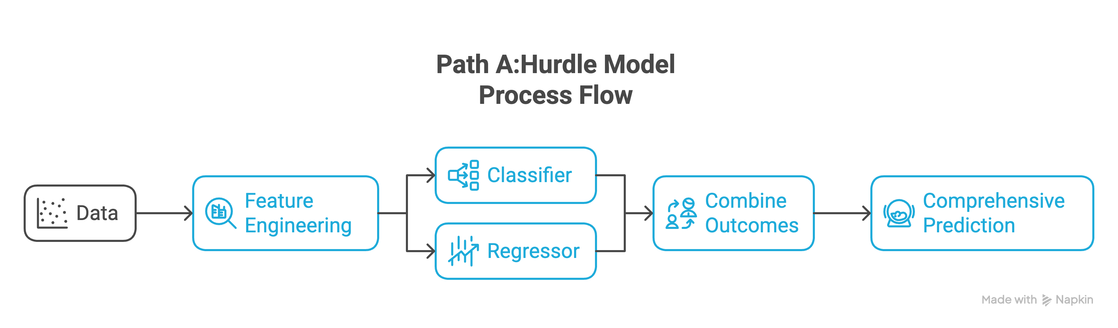
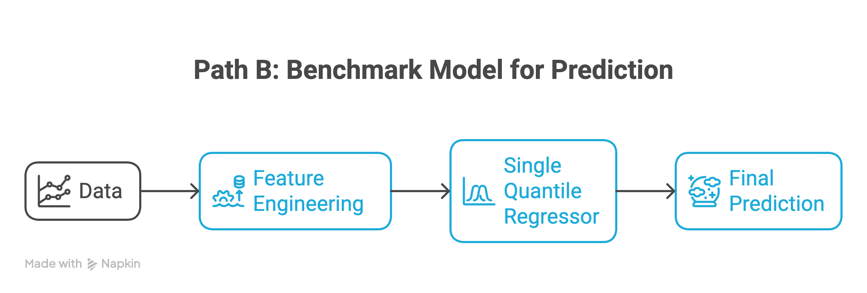

System Architecture: Two Paths to Prediction

Slide 6
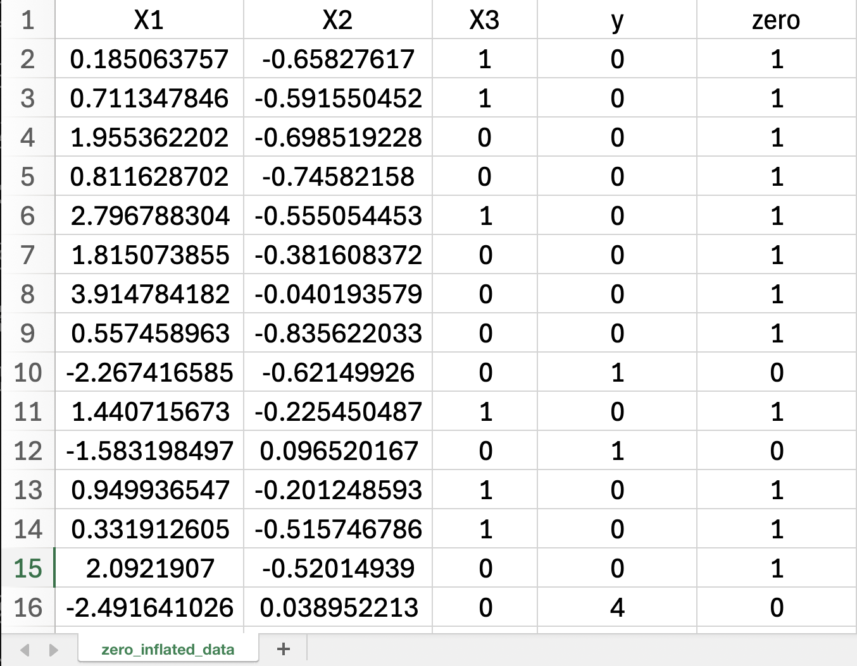
Data & Feature Engineering
Dataset
1
zero_inflated_data.csv
Base Features
2
3 raw predictors (X1, X2, X3).
Engineered Features
Expanded to 9 features to capture non-linearities.
3
Polynomials: X1², X2², X3²
Interactions: X1×X2, X1×X3, X2×X3

Slide 7
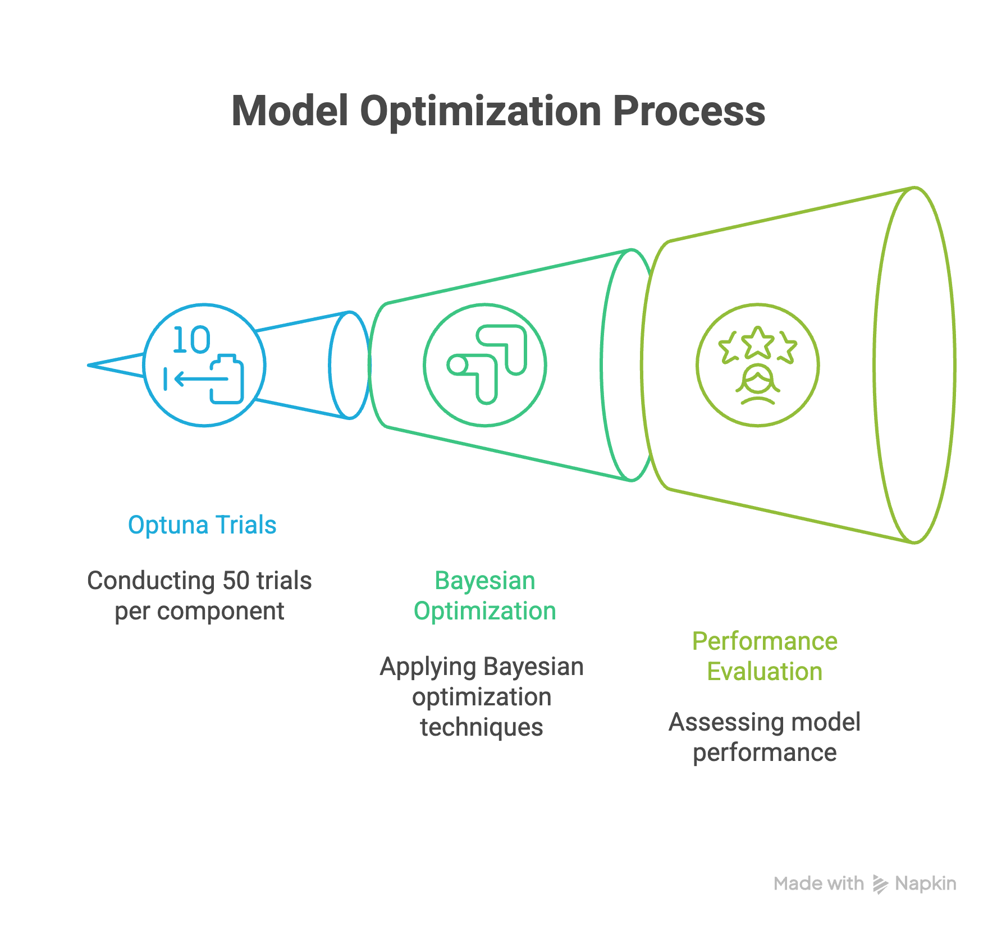
Hyperparameter Optimization

Slide 8
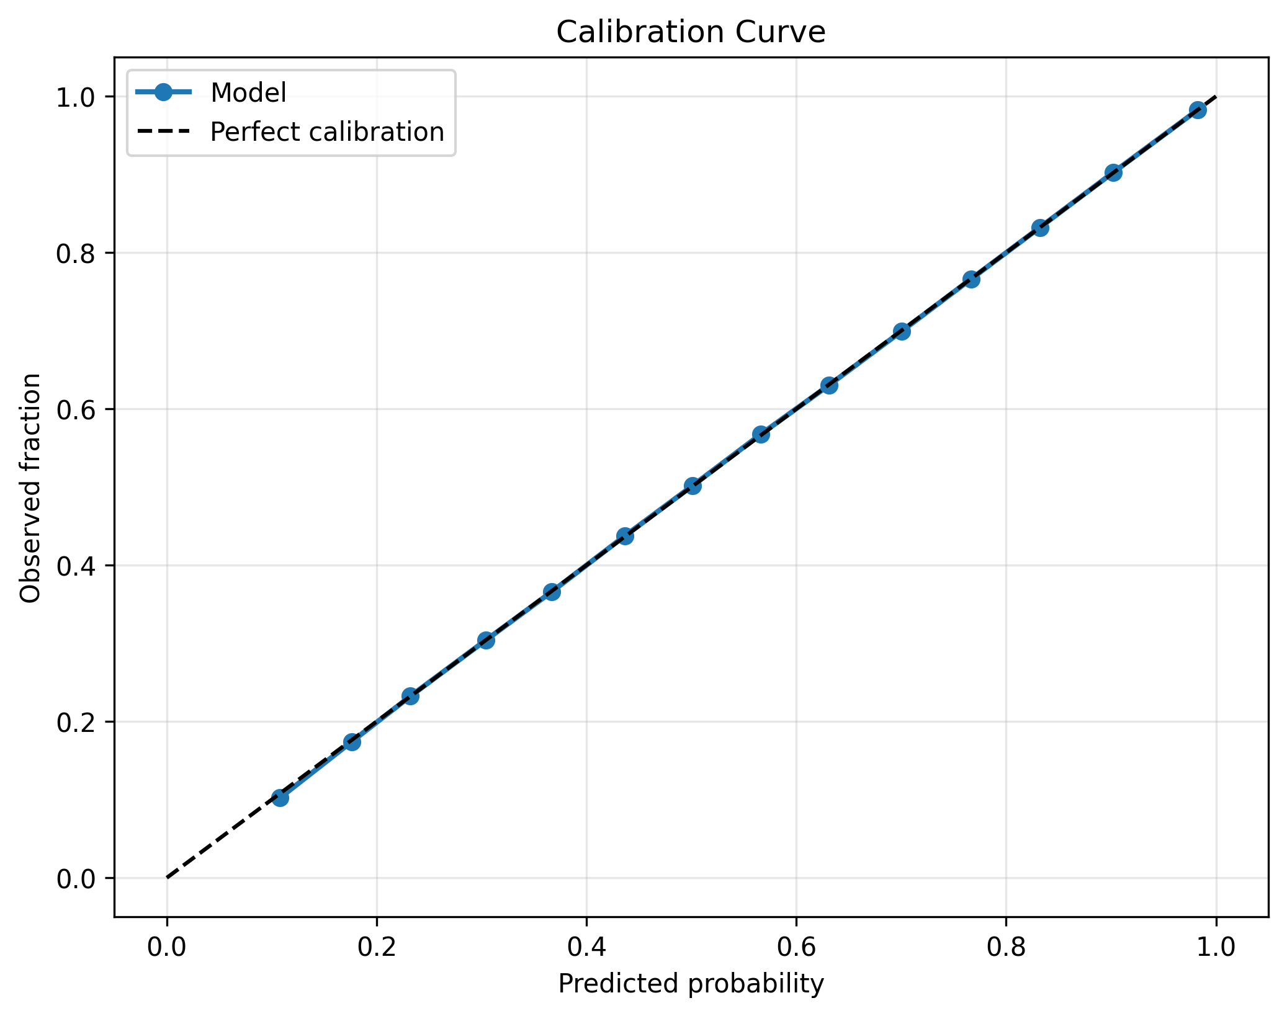
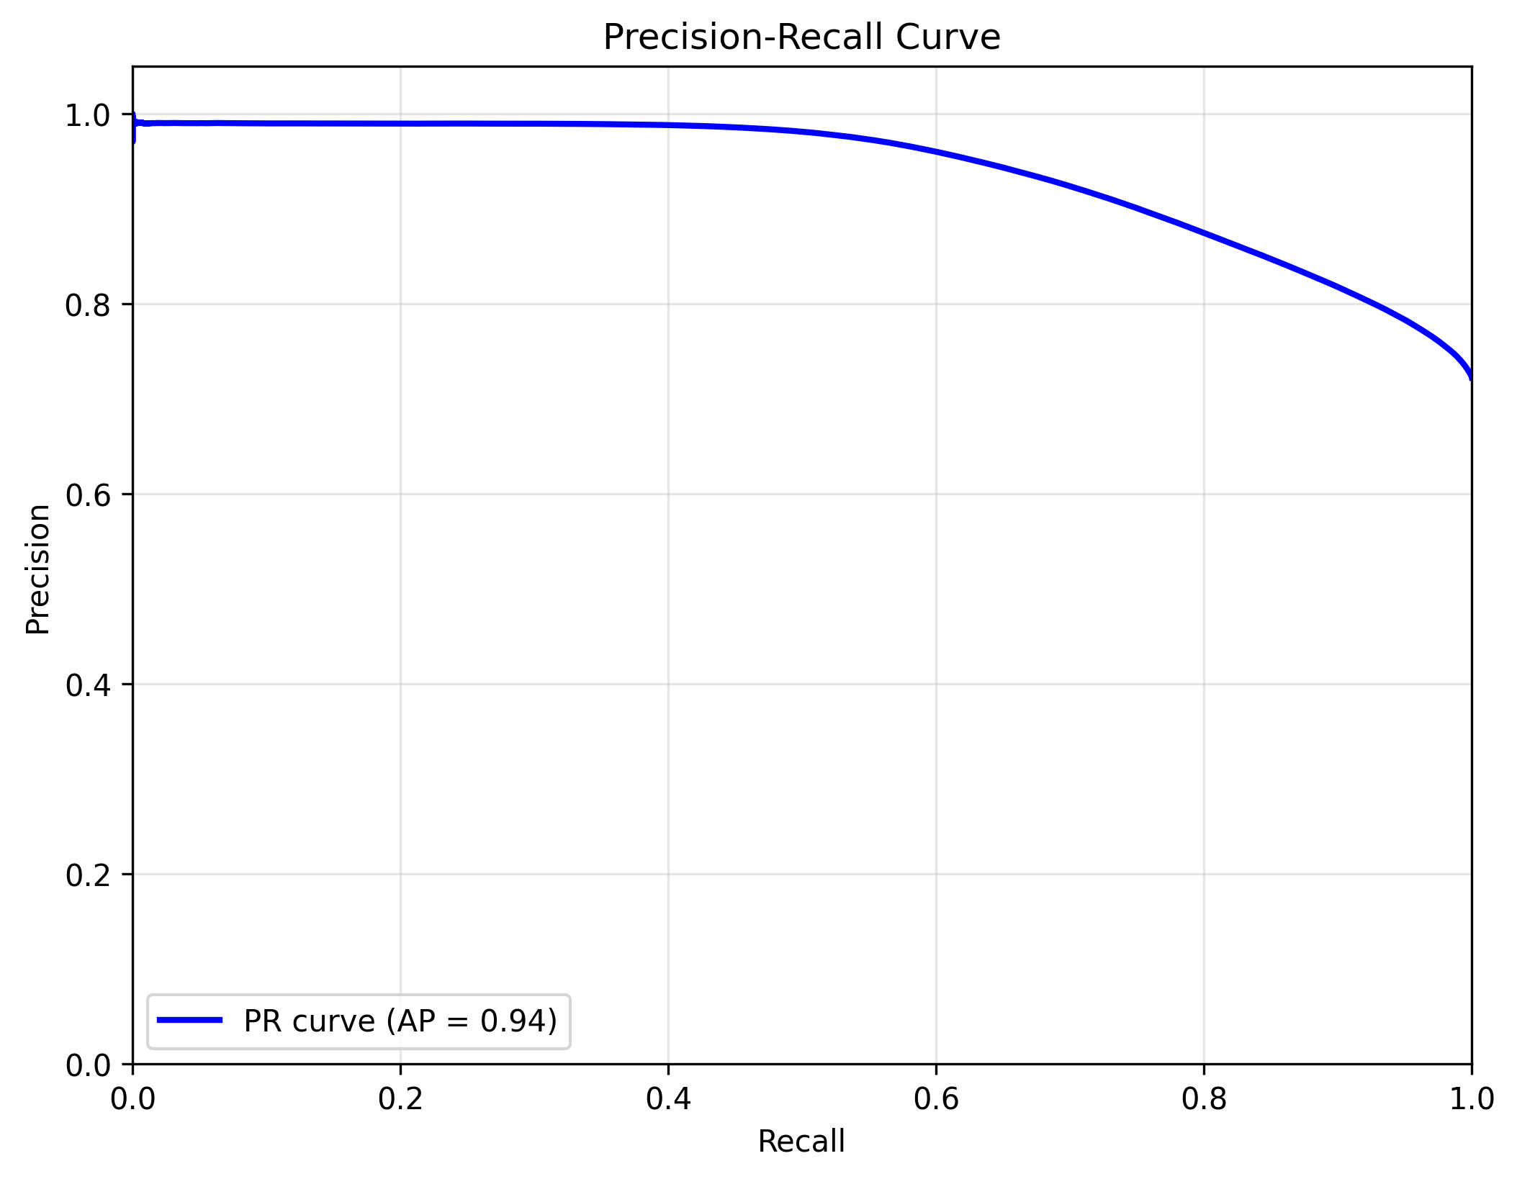
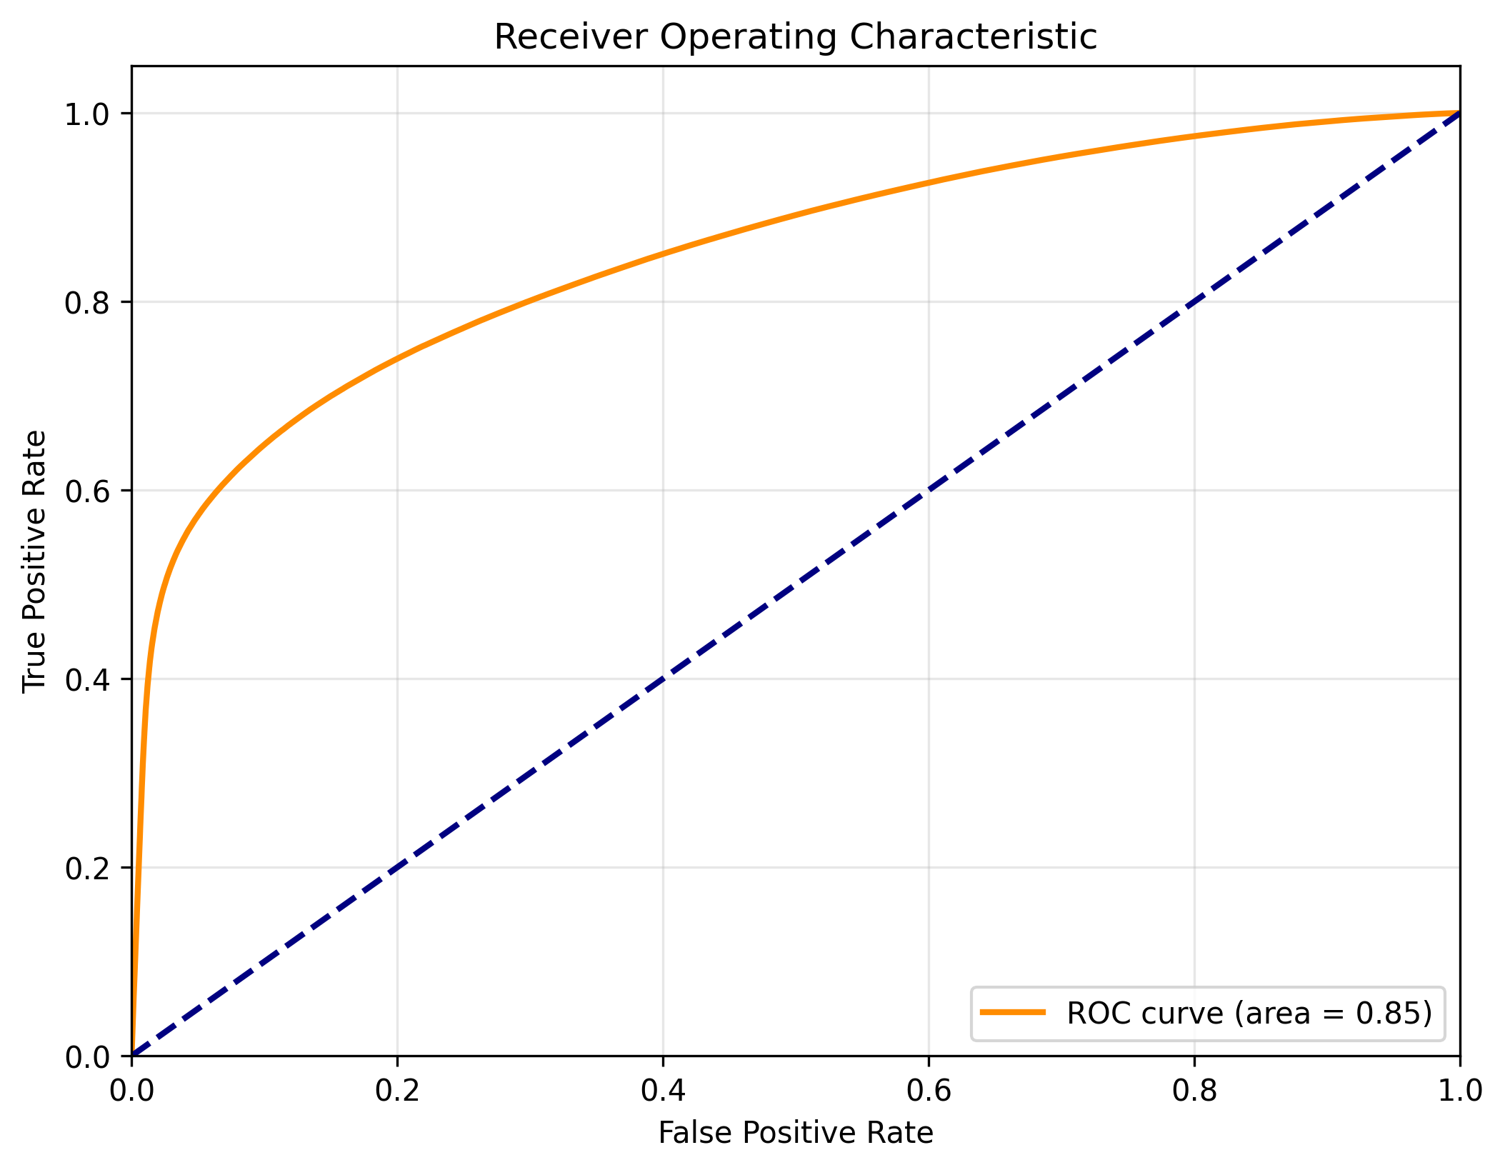
Results A – The Two-Stage Hurdle Model
The Good News (Stage 1 – Classifier Performance)
The classifier performed well in isolation, achieving a strong AUC of 0.85.

Slide 9
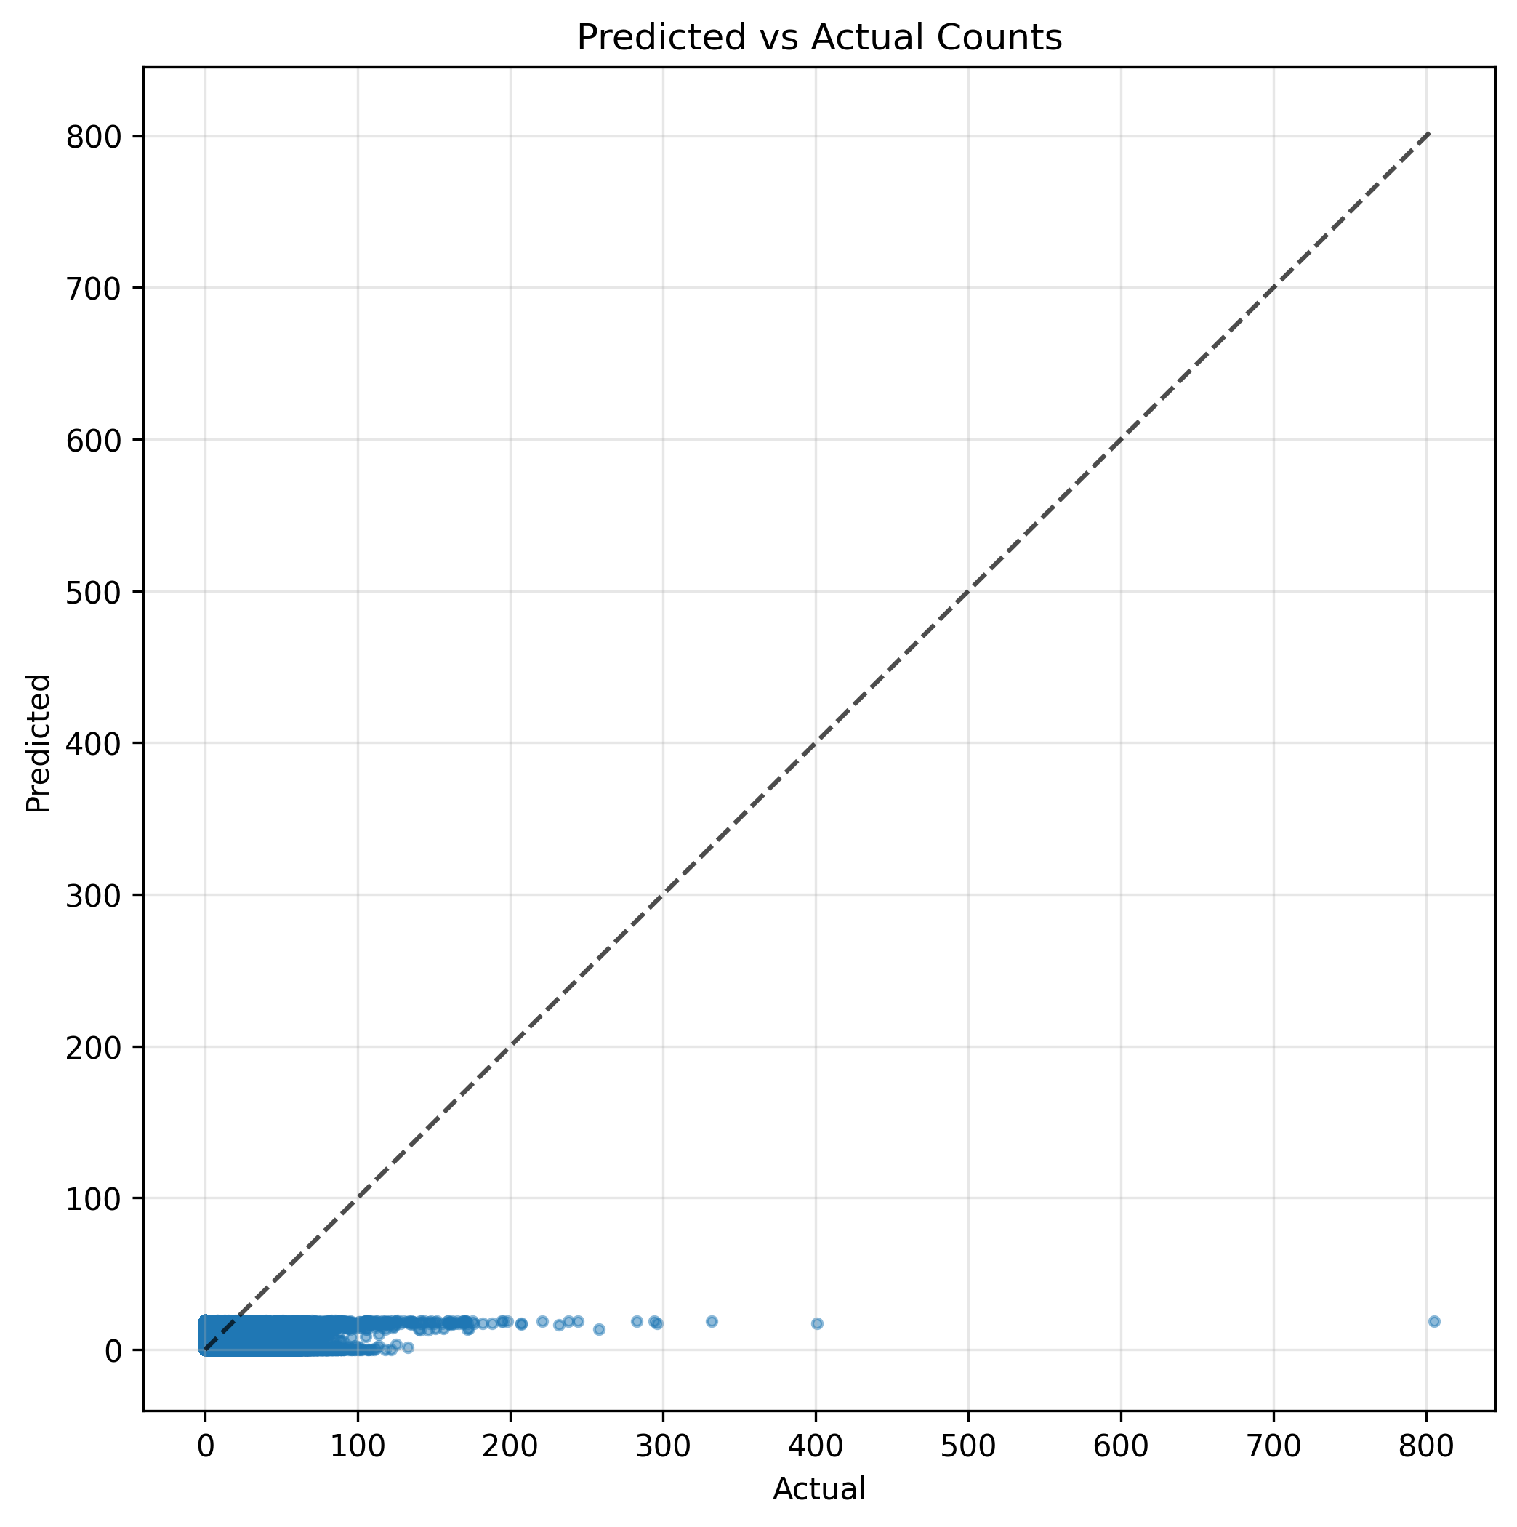
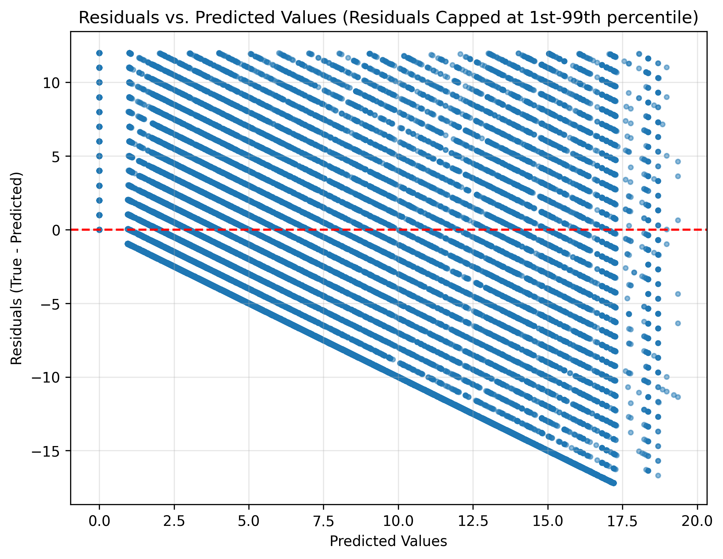
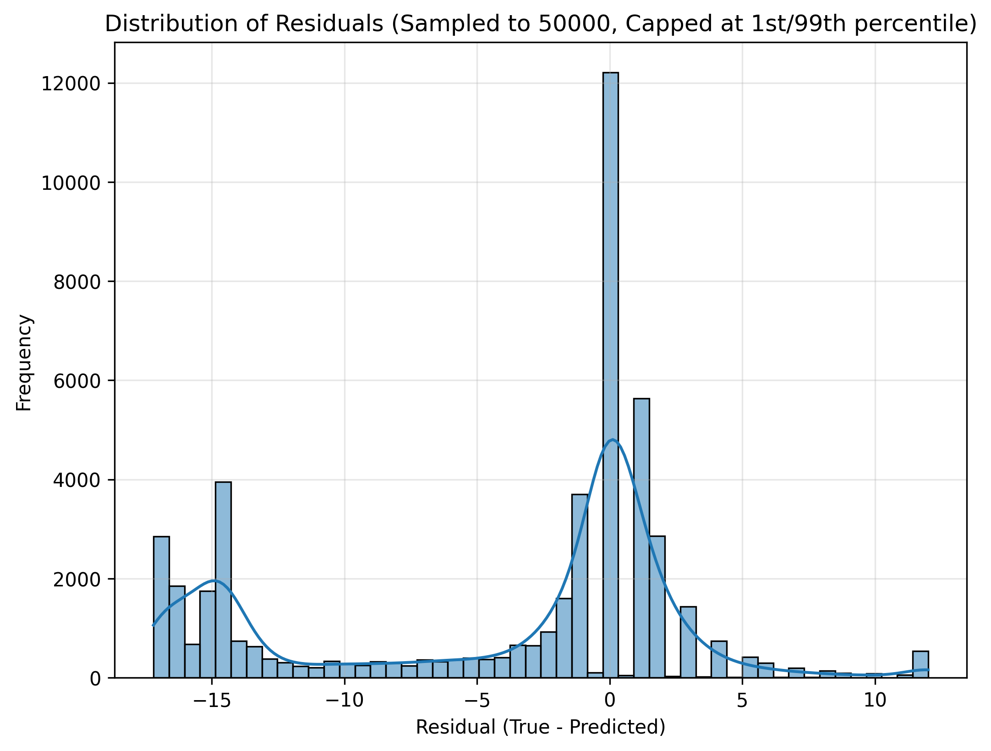

The Bad News (Overall Combined Model Failure)
The combined model’s predictive accuracy was poor.
MAE: 5.73
R-squared: –5.69

Slide 10
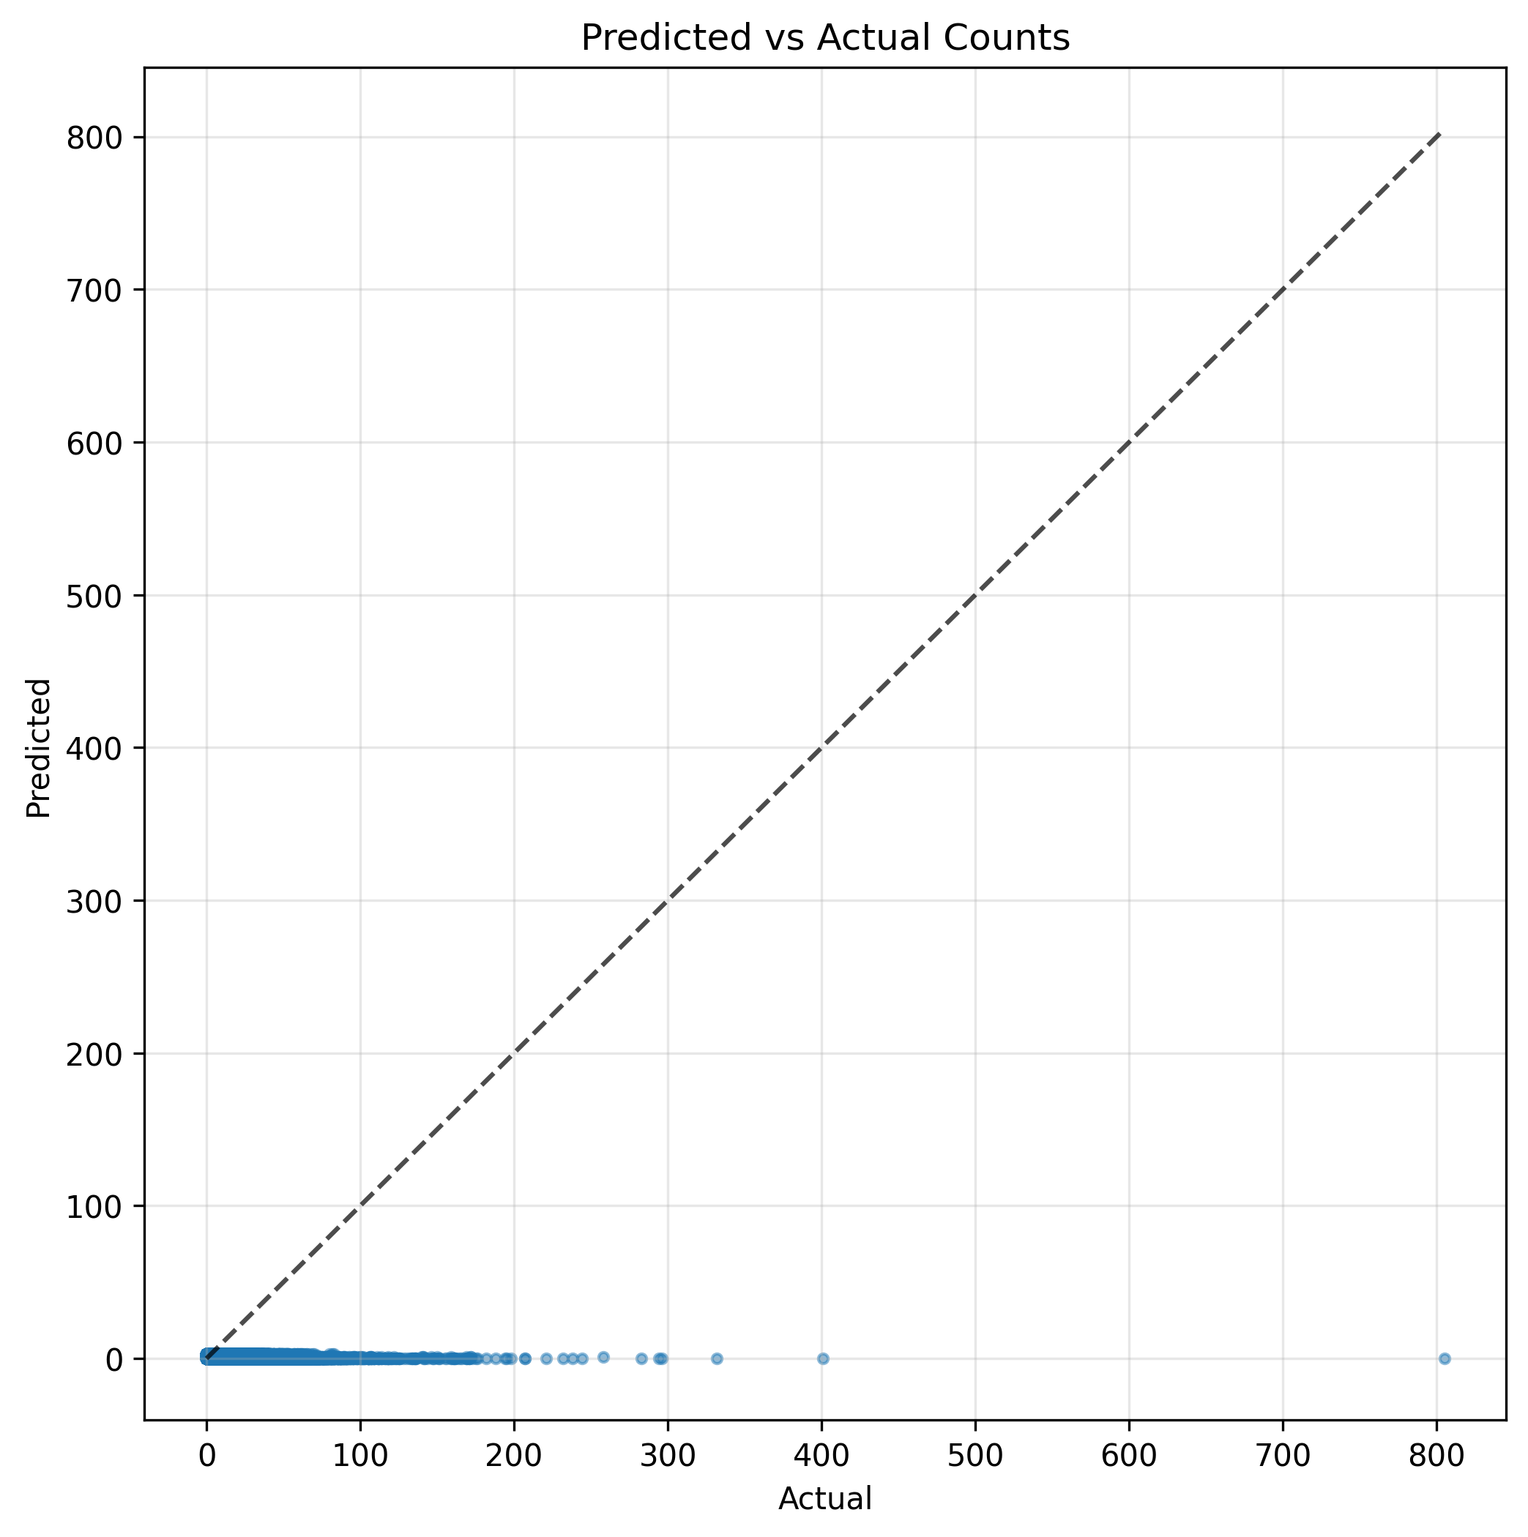
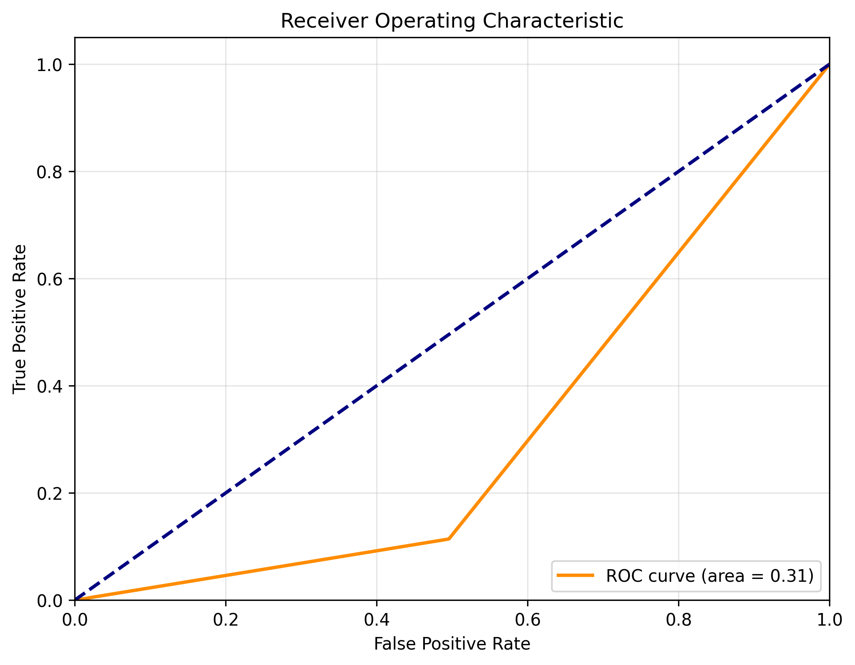
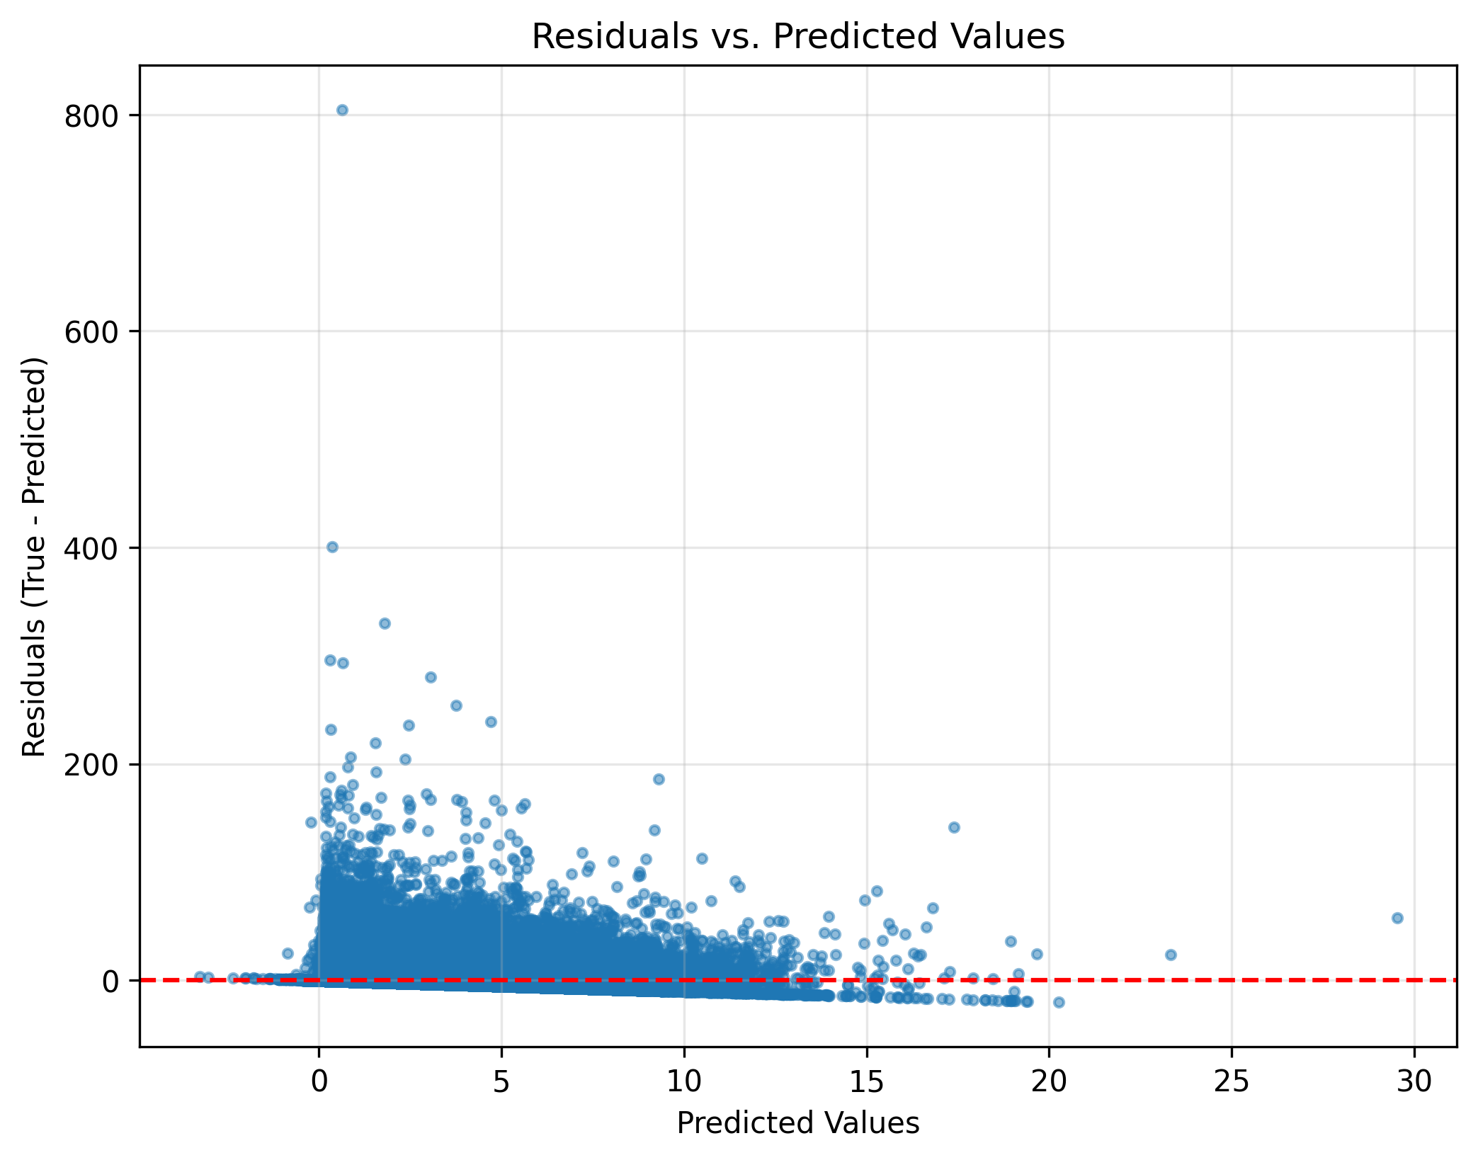
Results B – Benchmark Single Regressor Model
Overall Performance: The Clear Winner
MAE: 0.86
RMSE: 3.40

Slide 11
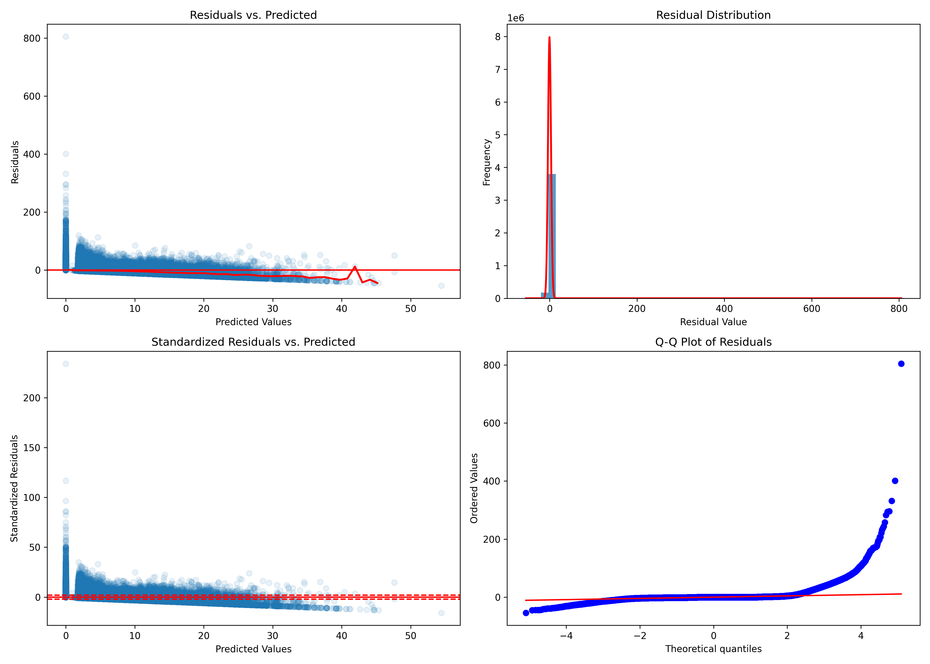
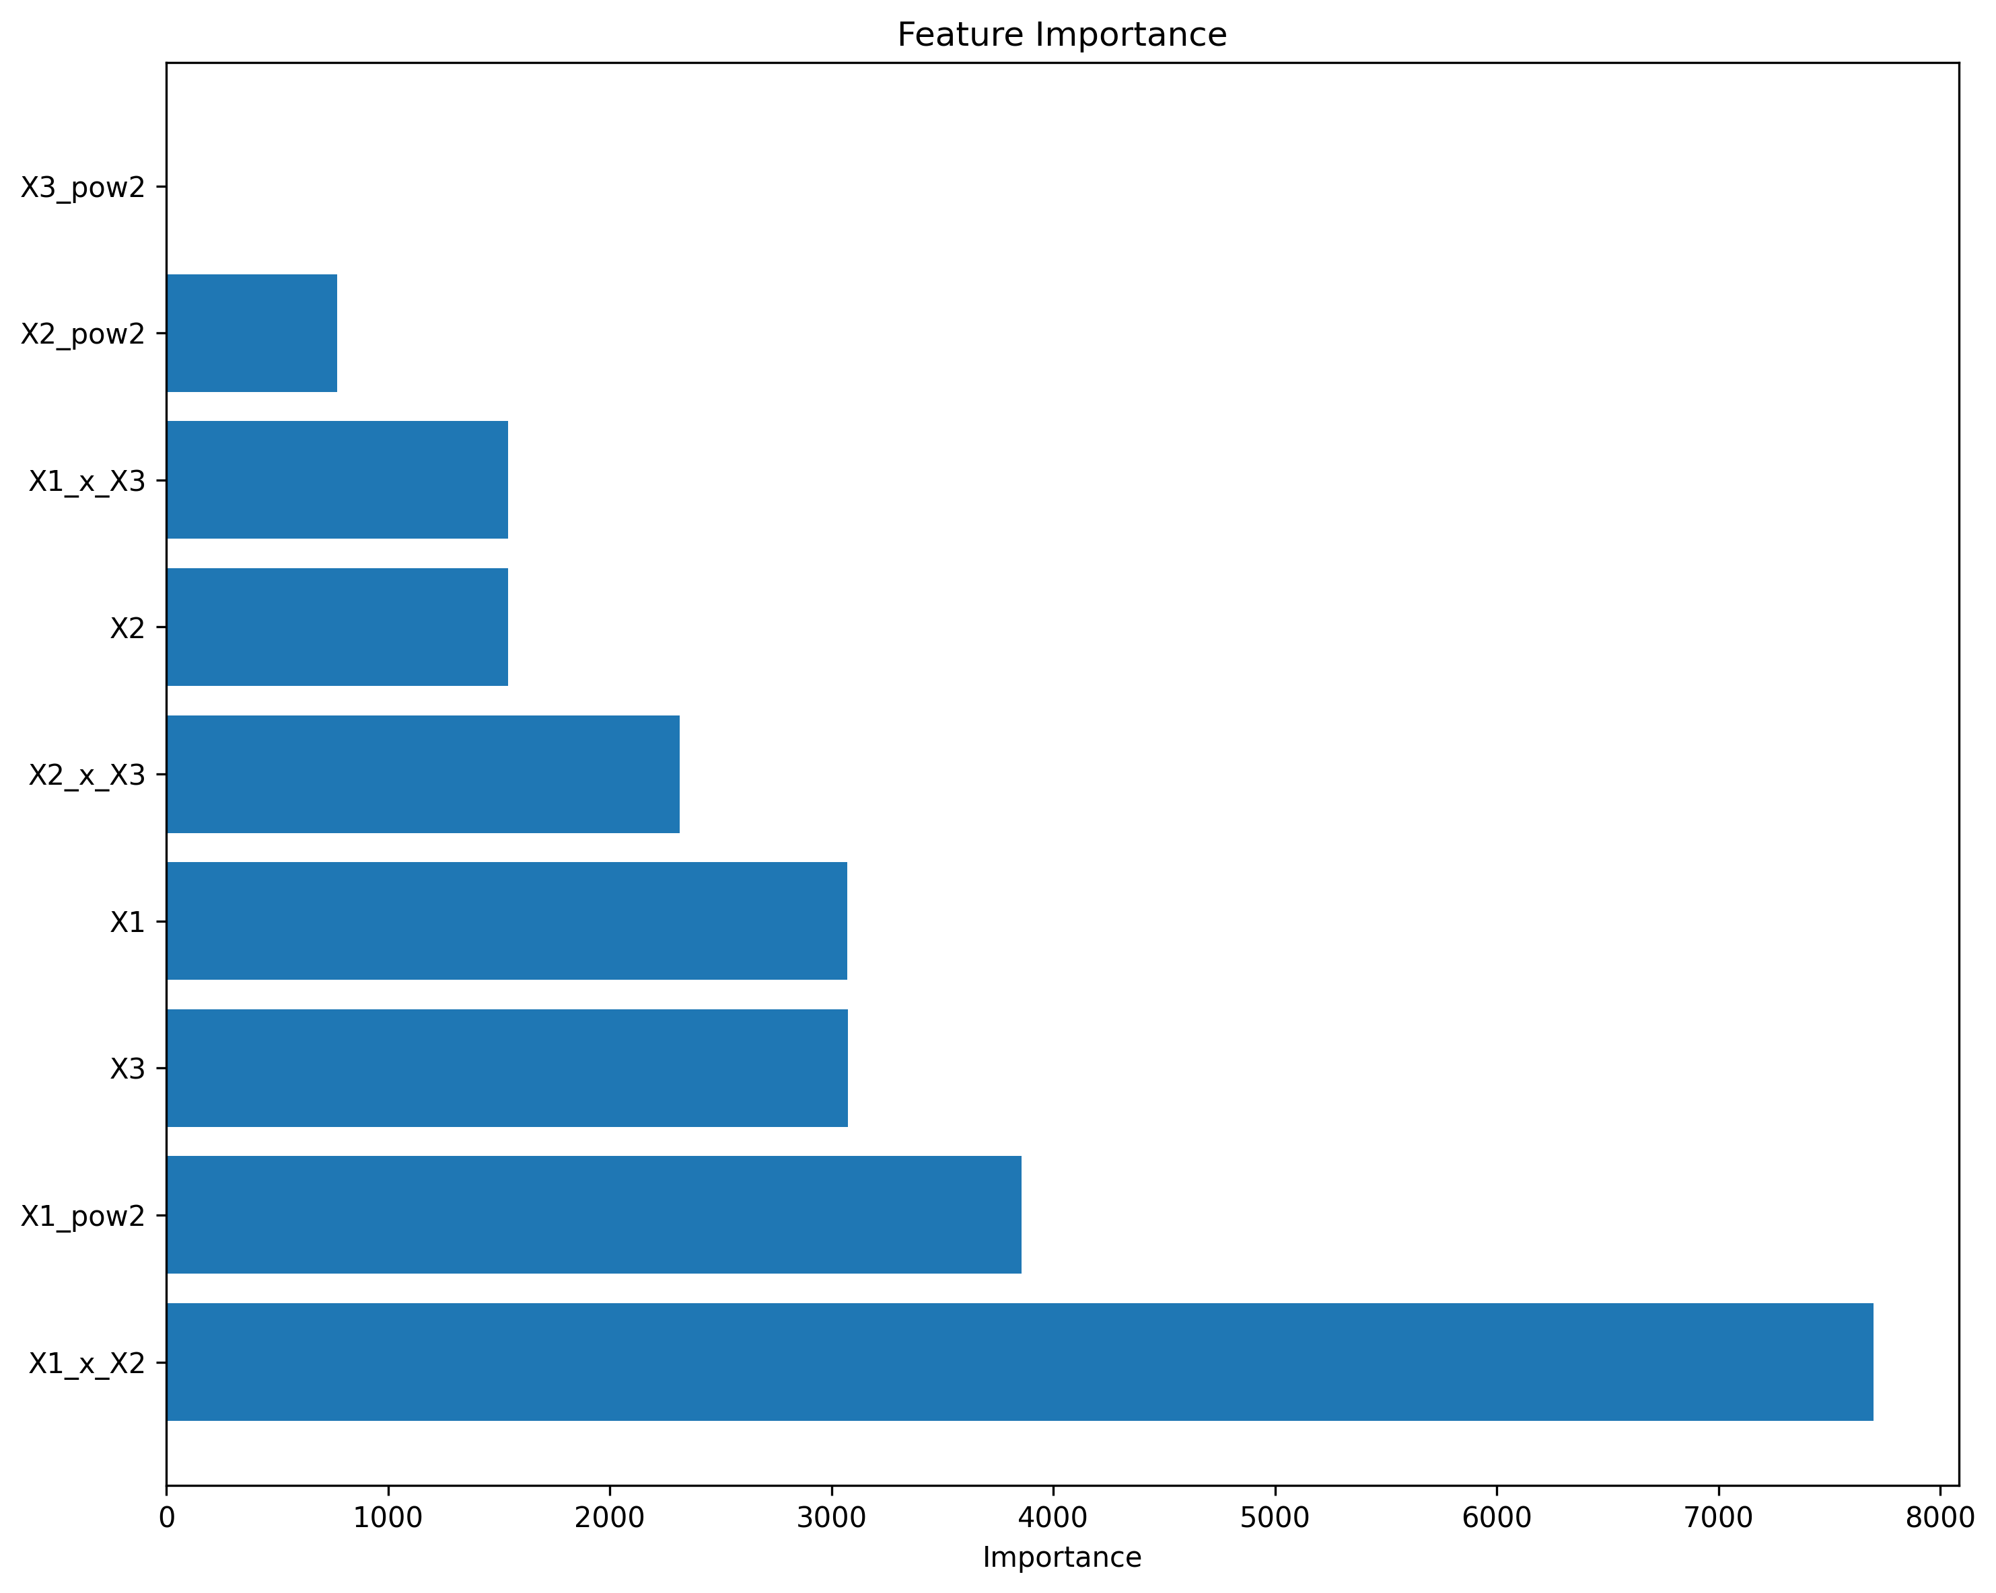
10

Slide 12
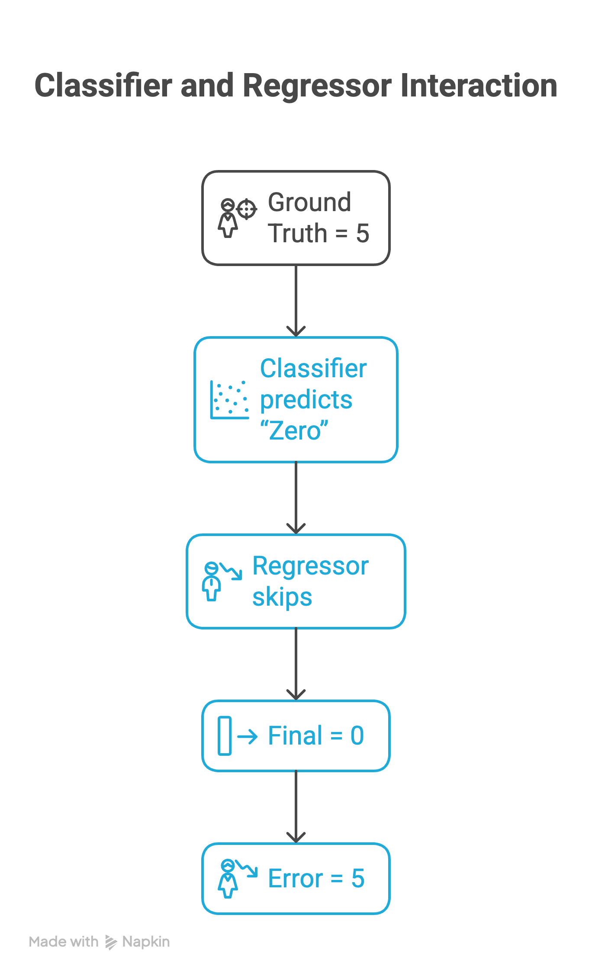
The “Aha!” Moment: Illustrating Error Propagation
Key Insight: In a two-stage hurdle model, one small mistake in the classifier stage can cascade into a very large final error.
Example Scenario:
Ground Truth: 5 complications
Classifier Prediction: “Zero”
Final Prediction: Forced to 0 → Error = 5
11

Slide 13
The Accuracy vs. Interpretability Trade-Off
Model | Predictive Accuracy | Analytical Interpretability
Benchmark (Single) | High (MAE 0.86, RMSE 3.40) ✅ ✅ | Low (only overall feature importances) ❌
Hurdle (Two-Stage) | Low (MAE 5.73, R² –5.69) ❌ ❌ | High (Clear zero-vs-nonzero drivers) ✅
Key Takeaway:
The benchmark model wins on raw prediction accuracy—errors are small and evenly distributed.
The hurdle model wins on interpretability—its first stage pinpoints exactly which factors drive a zero outcome.
Decision point: If your priority is accuracy, choose the single-stage regressor; if it’s understanding the drivers of zero vs. nonzero, use the two-stage approach.

Slide 14
Conclusion
The Surprise: Our initial hypothesis was disproven—the simpler model was 7× more accurate.
The Reason: For this problem, the risk of error propagation in the multi-stage model outweighed the theoretical benefits of its specialized design.
The Recommendation: When predictive accuracy is the primary goal, a single, robust regression model is the more reliable strategy.
Operational Benefit: Single-stage models are easier to deploy, maintain, and scale in production.
Caveat: The two-stage approach still offers unique insights into zero–vs–nonzero drivers, which can be critical for domain-specific decision-making.
13

Slide 15
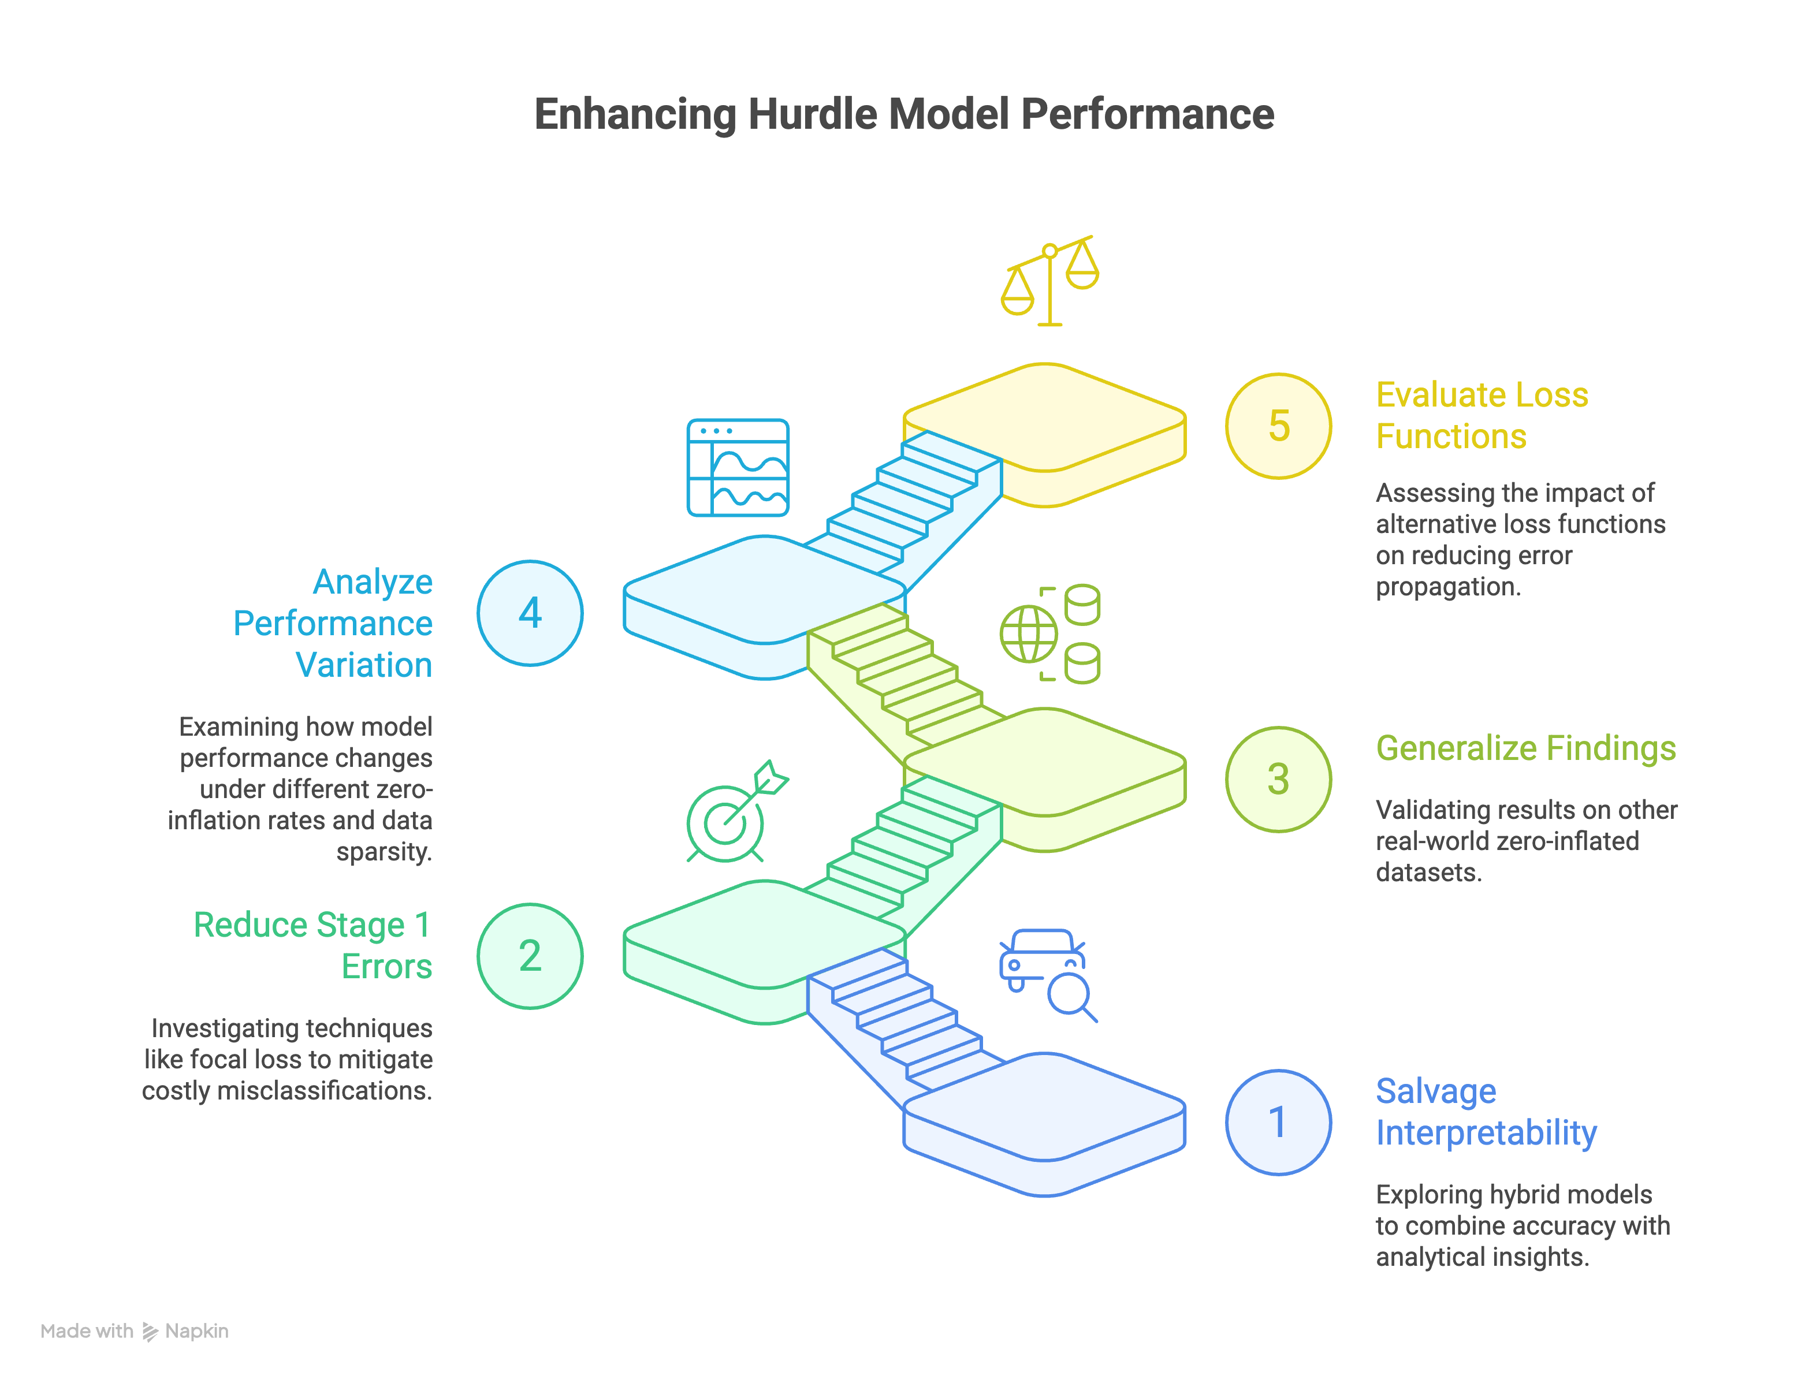
Future Work: Open Research Questions
14

Slide 16


Thank You.
Trinity College Dublin, The University of Dublin

